Slide 1
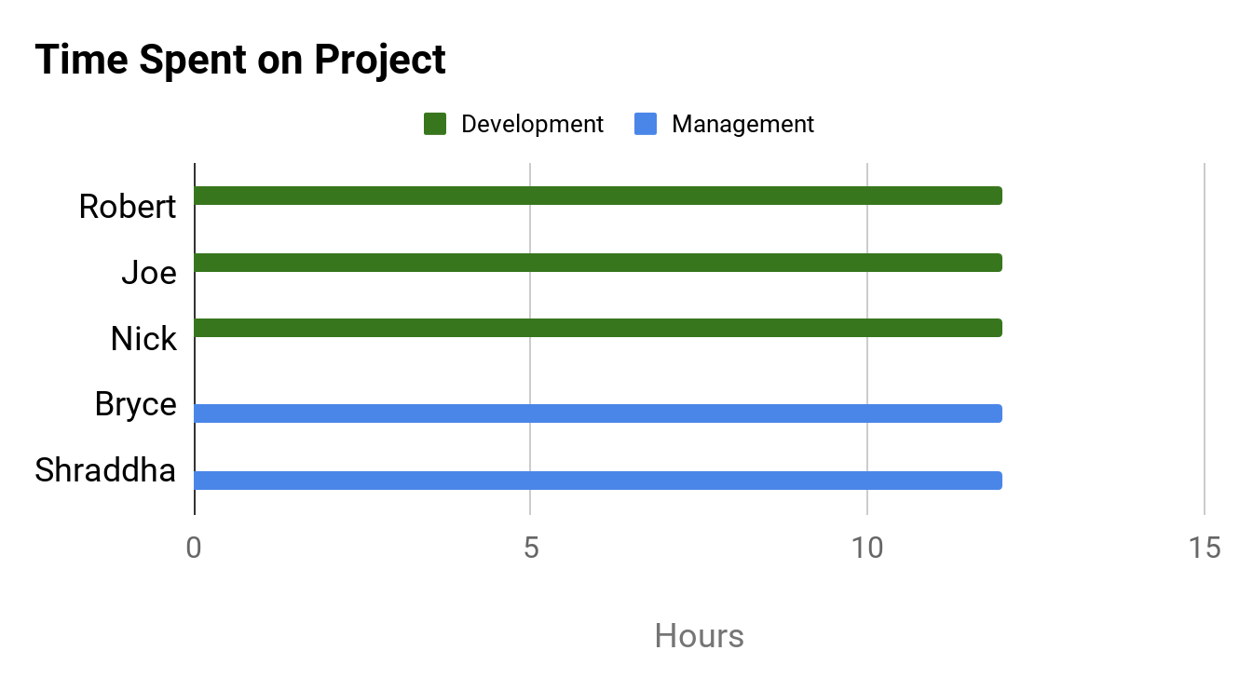
PROJECT DASHBOARD: HAX CMS MICROSERVICE
TEAM: #1
DATE: 12-APR-2020
PREVIOUS TASKS
On Target | At Risk | Attention Needed | Not Applicable
PROJECT STATUS
KEY PERFORMANCE INDICATORS
Met with Mr. Ollendyke to discuss final expectations and current product
Tested Windows/UNIX compatibility
On Target | At Risk | Attention Needed | Not Applicable
COMPLETED TASKS
Overall: On Target
Time: On Target
CURRENT TASKS
Scope: On Target
Determine which file conversions work
Test using created scripts
Work on Training and Handoff plans
Cost: No Budget
RISK STATUS
TASK | PROGRESS
Development Work
Create/Perform Tests
Create Training & Handoff Plans
On Target | At Risk | Attention Needed | Not Applicable
Risk 1: Time Constraints
100%
ISSUES NEEDING ATTENTION
Risk 2: Lack of Development Support
No issues at this time
Risk 3: GitHub Change Compatibility
75%
Risk 4: Stray from Original Scope
Risk 5: Remote Collaboration
15%

